Slide 1



Gym Management System
By: Trivon, Ryan, and Anthony

Slide 2
Description
z
This database is designed to address the need for efficient management and organization of a gym’s operations, including equipment tracking, employee supervision of members, and membership type management.

Slide 3
Overview
z
Employees:
Contains information about gym staff (Name, Employee ID, hire date, number of members supervised, and supervisor).
Each employee can be associated with multiple pieces of equipment.
Each employee can supervise one or more members.
Equipment:
Stores data about the gym's equipment inventory (Equipment ID, Cost, Daily usage in regards to time, and the employee assigned).
Each piece of equipment is assigned to an employee (e.g., for maintenance or oversight).
Members:
Contains details about gym members (Name, join date, last visit, and total visits).
Each member may have a membership type, specifying their access and benefits.
Members can be supervised by one employee.

Slide 4
Overview Cont.
z
Supervisors:
Keeps track of the supervisory relationships within the gym.
Employees may have other employees as supervisors.
Membership_Types:
Defines various membership categories and their cost.
Membership types are linked to members to specify their privileges and access.

Slide 5

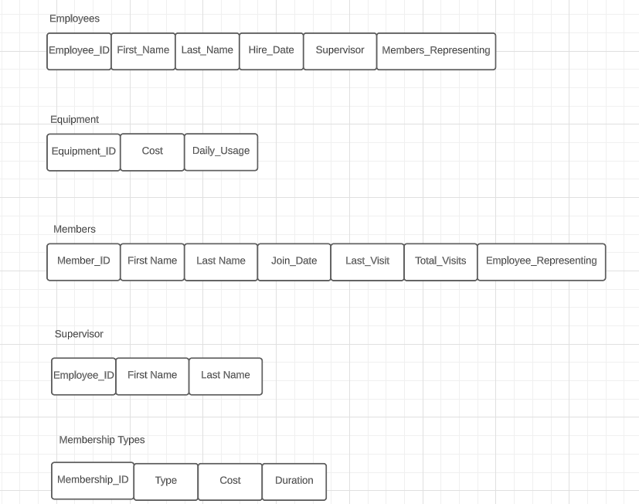
Table Structures
z

Slide 6
Equipment
z
Equipment_ID
Daily Usage
Cost

Slide 7
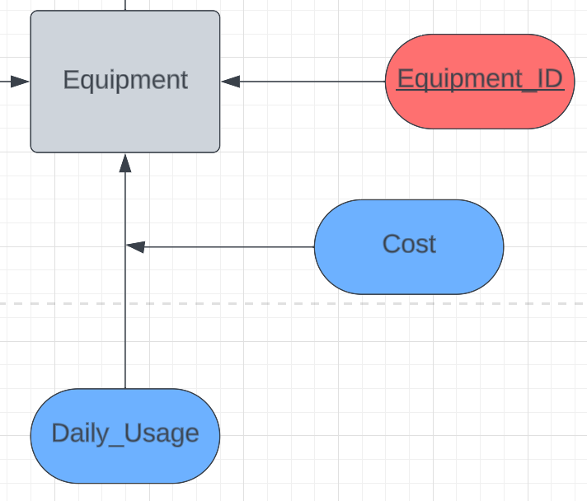

Slide 8
Employees
z
Employee_ID
First Name
Last Name
Hire Date
Members Representing

Slide 9
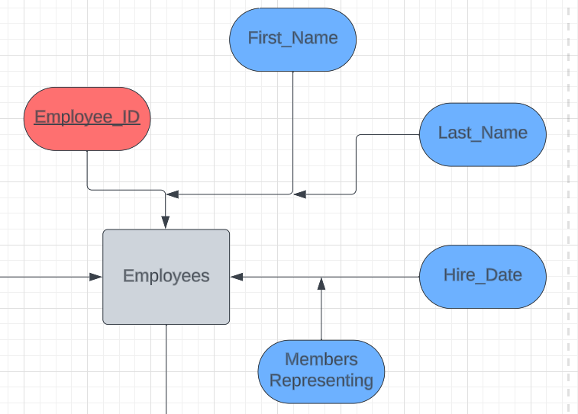

Slide 10
Members
z
Member_ID
First Name
Last Name
Join Date
Last Visit
Total Visits
Employee Representing

Slide 11
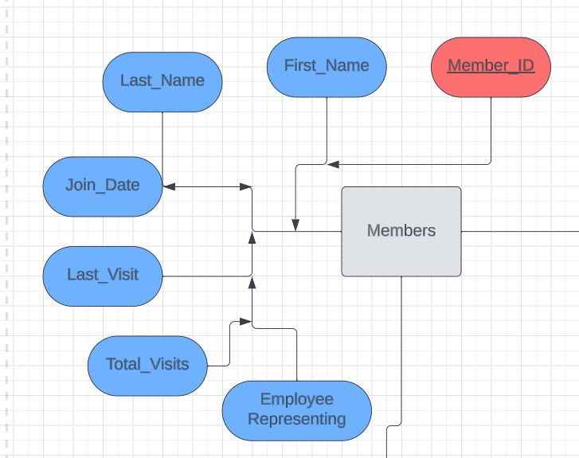

Slide 12
Supervisor
z
Employee_ID
First Name
Last Name

Slide 13
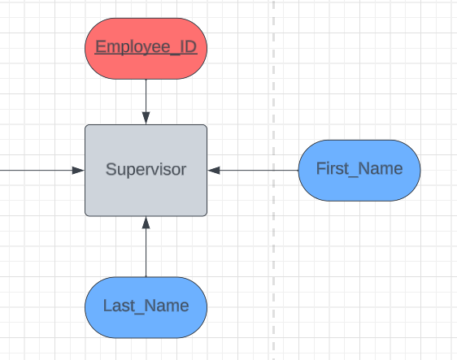

Slide 14
Membership Types
z
Membership_ID
Type
Cost
Duration

Slide 15
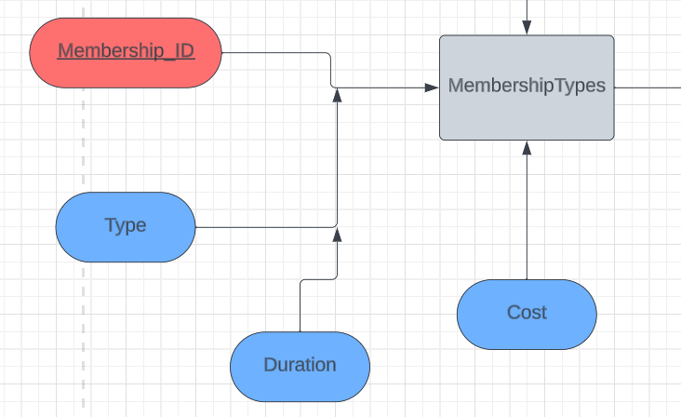

Slide 16
